Slide 1



Order-based Structure Learning without Score Equivalence
Hyunwoong Chang
Department of Statistics
Texas A&M University
with James Cai and Quan Zhou
Bayesian structure learning in complex settings

Slide 2
In today’s talk…
Introduction to structure learning
Computational challenges of Bayesian structure learning of DAG models
Our approach to tackling the challenges
Results

Slide 3


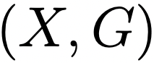

Motivation
?
association

Slide 4
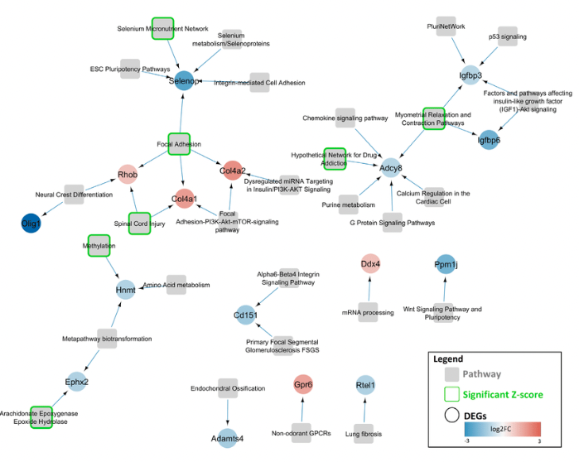
Motivation
Golden rules: intervention/RCT
expensive
unethical
Discovering relational graph by using
pure observational data
partially experimental data
Structure learning contains
Directed graph/undirected graph/cyclic graph
An illustration of a gene regulatory network
Source: CyTargetLinker app update: A flexible solution for network extension in Cytoscape

Slide 5
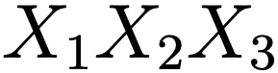
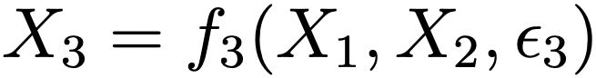
Structural equation model (SEM)
Example
A directed acyclic graph (DAG)

Slide 6
DAG model (Bayesian Network)
Probabilistic graphical model with directed acyclic graph (DAG)
If the distribution of is Markovian to the DAG , conditional independence
relation can be read off from by ‘d-separation’ rule.
It is useful to calculate the marginal probability or conditional probability of .
Markov equivalence class (MEC)
A set of DAGs encode the same conditional independence relations.
Example
X₂
X₂
X₂
X₁
X₁
X₁
X₃
X₃
X₃
Non-identifiability: Markov equivalent DAGs

Slide 7
Structure learning of DAG models
Given data , recovering the DAG that has the ‘‘best fit’’
in terms of conditional independence.
Score equivalence
Assigning the same score (posterior) for all Markov equivalent DAGs.
Most score-based methods used in practice are score equivalent.

Slide 8
Bayesian structure learning of DAG models
Challenge: massive number of DAGs
increases super-exponentially with the number of nodes 𝘱.
more than 10³⁶ labeled DAGs on 𝘱 = 14.
G₁
G₃
G₂
⟹ Markov chain Monte Carlo (MCMC)
Posterior distribution on DAG space
*blue bars: posterior probability on each DAG

Slide 9
Previous works
Structure MCMC (Madigan et al., 1995)
X₂
Problem: known to have slow mixing.
1) Small neighborhood*
→ introducing new DAG operations.
(Grzegorczyk and Husmeier, 2008, Su and Borsuk, 2016)
X₁
edge addition
X₃
X₂
X₁
X₂
X₃
X₁
edge deletion
current DAG
X₃
2) Traversing MECs and score-equivalence.
X₂
X₁
edge reversal
X₃
local proposal DAGs

Slide 10
Problem: traversing score-equivalent DAGs.
G*
The states with blue bars are MECs.
The same heights indicate the score equivalence.
- Hard to move toward high posterior region.
G

Slide 11
Previous works
MCMC on the MEC space (Castelletti et al., 2018, Zhou and Chang, 2021)
- Running MCMC on the Markov equivalence class space.
😊 Generally good mixing performance.
😥 Implementation of MEC operators is complicated.

Slide 12
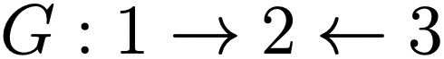
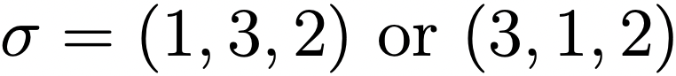
Previous works
Order MCMC (Friedman and Koller, 2003, Agrawal et al., 2018.)
Topological ordering of DAG G : a linear extension of partial ordering from an edge set of G, presented as a bijection
meaning that if , the direction of edge should always be
Example

Slide 13
Previous works
Order MCMC (Friedman and Koller, 2003, Agrawal et al., 2018.)
Once the ordering of variables is fixed, structure learning can be reduced to a collection of variable selection problems.
Giving a score on each ordering by summing over the scores of (a subset of)
the compatible DAGs and running MCMC on the ordering space.
😊 Generally faster mixing than structure MCMC.
😥 Still traversing MECs.

Slide 14
Our approach: identifiability conditions
Score equivalence property → poor convergence of MCMC
Imposing identifiability → model without score equivalence → better convergence
Linear structural equation models (SEMs) with equal error variances.
(Peters and Bühlmann, 2014)

Slide 15
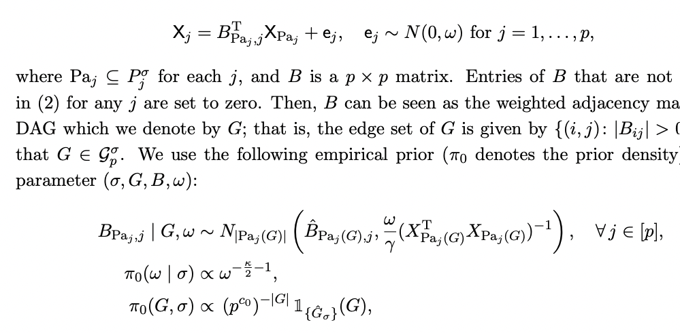
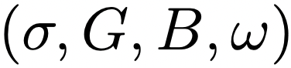
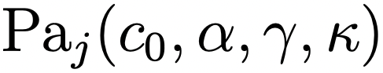
Model specification
Linear structural equation model with equal error variances
Prior specification on parameters : empirical normal-inverse-gamma.
: a parent set of j.
: hyperparameters

Slide 16
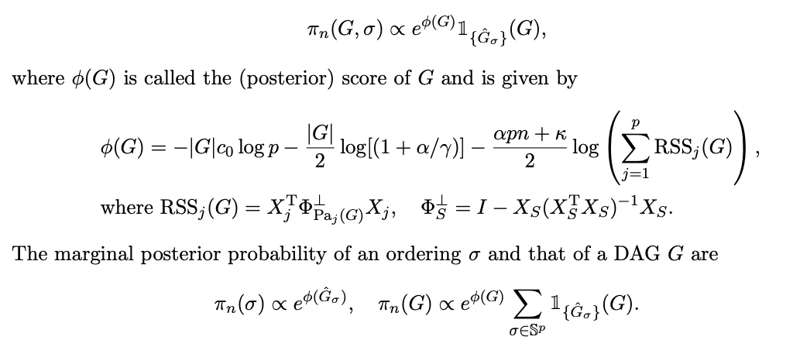
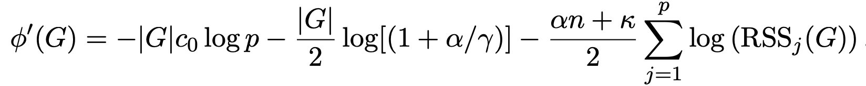
Model specification
Marginal posterior distributions
Posterior score (without score-equivalence)
where is the residual sum of squared of node j
※ Comparing with score equivalent score

Slide 17
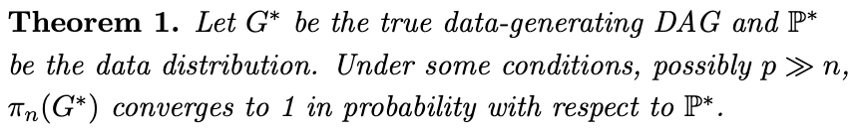
Strong model consistency

Slide 18
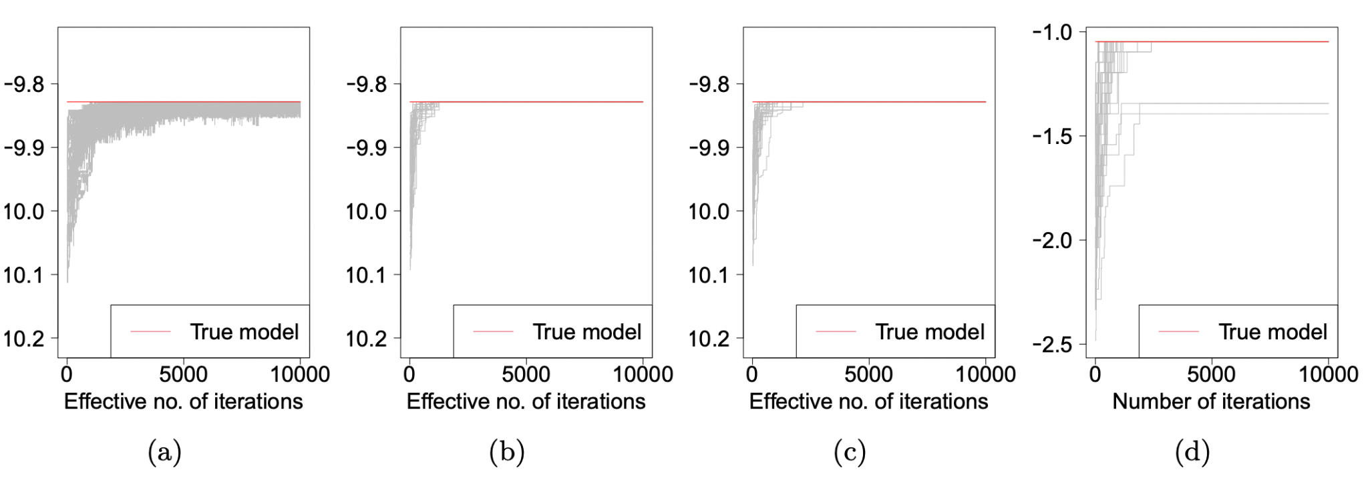
Order-based MCMC: posterior sampling
Possible neighborhood operators on ordering space.
a
b
a
b
a
b
b
a
b
a
b
a
adjacent transpositions
random transpositions
random-to-random shuffle

Slide 19
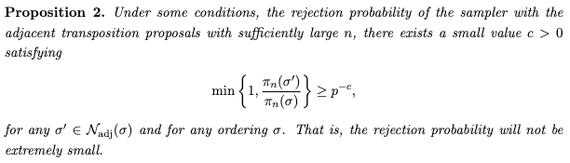
Mixing of order-based MCMC under the model specification

Slide 20
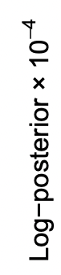
Simulation studies - mixing behavior
Posterior traceplots - a random 20-node DAG with 30 MCMC chains.
the proposed model w/
adjacent transpositions
the proposed model w/
random transpositions
the proposed model w/
random-to-random shuffle
score equivalence w/
adjacent transpositions

Slide 21
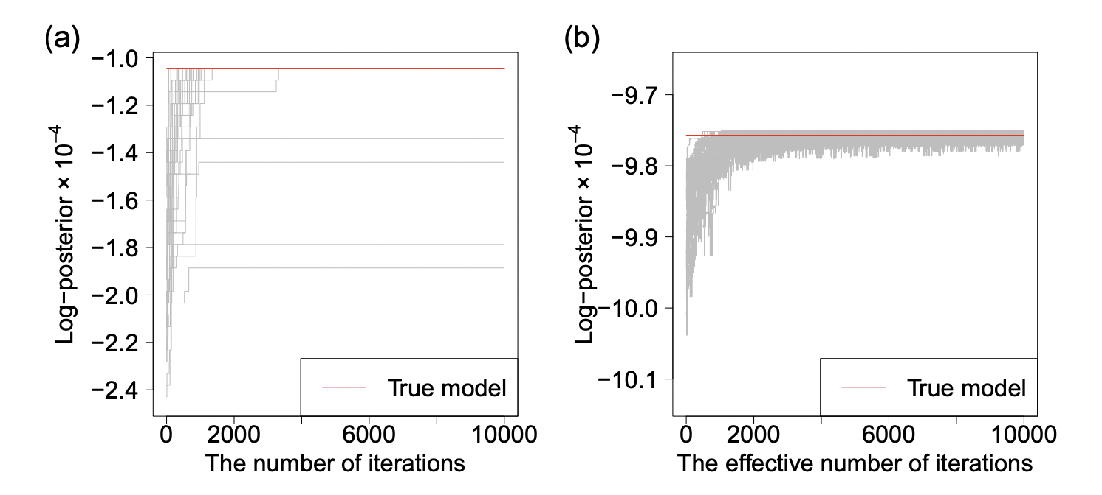
Simulation studies - mixing behavior (misspecified case)
Posterior traceplots - a random 20-node DAG with 30 MCMC chains.
the proposed model w/
adjacent transpositions
score equivalence w/
adjacent transpositions

Slide 22
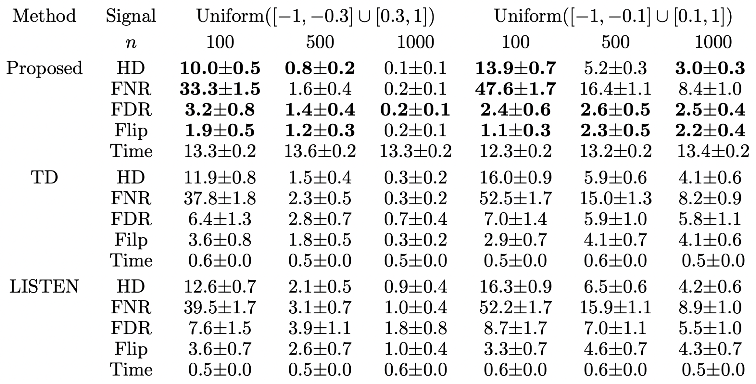
Simulation studies - performance evaluation
*30 replicates of random 40-node DAGs. (Lower the better)

Slide 23
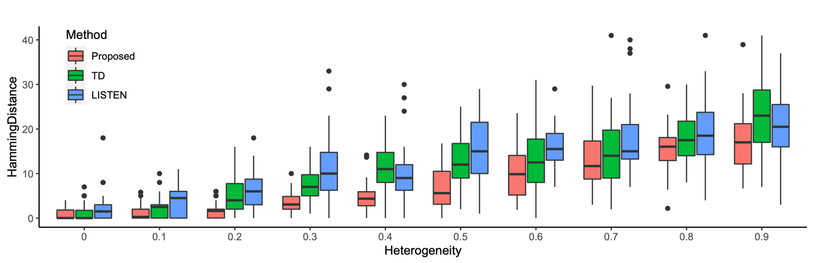
Simulation studies - performance evaluation
Hamming distance according to the degree of heterogeneity of error variances

Slide 24
Real data analysis
The single-cell RNA data for Alzheimer’s disease (scREAD, control vs. case)
After preprocessing, 2,300 control samples and 1,666 case samples (p = 73).
Objective: learning two DAGs (control vs. case) and comparing them.
Running 30 MCMCs (200K iterations with 100K burn-in) on two datasets.
Gelman-Rubin (GR) factors for each directed edge.
Ours (without score equivalence)
Minimal I-MAP MCMC (with score equivalence)
 | control | case
GR ≤ 1.1 | 99.7 %
max GR | 2.56 | 1.26
 | control | case
GR ≤ 1.1 | 93.7 %
max GR | inf (90 directed edges)

Slide 25
Summary
Computational challenges on learning DAG model due to traversing MECs.
Our approach is to impose an identifiability condition on model and break the score equivalence.
We discuss in theory and simulation studies that our order-based sampler under the model has good mixing property.

Slide 26
References
David Madigan, Jeremy York, and Denis Allard. Bayesian graphical models for discrete data. International Statistical Review/Revue Internationale de Statistique, pages 215–232, 1995.
Marco Grzegorczyk and Dirk Husmeier. Improving the structure MCMC sampler for Bayesian networks by introducing a new edge reversal move. Machine Learning, 71(2-3):265, 2008.
Chengwei Su and Mark E Borsuk. Improving structure MCMC for Bayesian networks through Markov blanket resampling. The Journal of Machine Learning Research, 17(1):4042–4061, 2016.
Federico Castelletti, Guido Consonni, Marco L Della Vedova, and Stefano Peluso. Learning Markov equivalence classes of directed acyclic graphs: an objective Bayes approach. Bayesian Analysis, 13 (4):1235–1260, 2018.
Nir Friedman and Daphne Koller. Being bayesian about network structure. a Bayesian approach to structure discovery in Bayesian networks. Machine learning, 50(1):95–125, 2003.
Raj Agrawal, Caroline Uhler, and Tamara Broderick. Minimal I-MAP MCMC for scalable structure discovery in causal dag models. In International Conference on Machine Learning, pages 89–98, 2018.
Quan Zhou and Hyunwoong Chang. Complexity analysis of Bayesian learning of high-dimensional DAG models and their equivalence classes. arXiv preprint arXiv:2101.04084, 2021.
Jonas Peters and Peter B¨uhlmann. Identifiability of Gaussian structural equation models with equal error variances. Biometrika, 101(1):219–228, 2014.

Slide 27
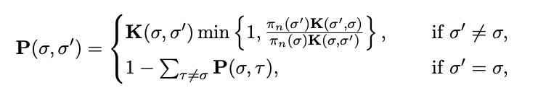
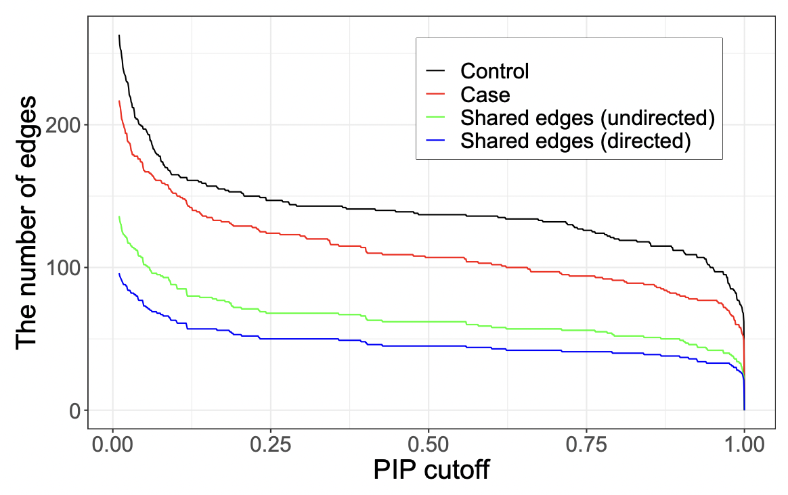
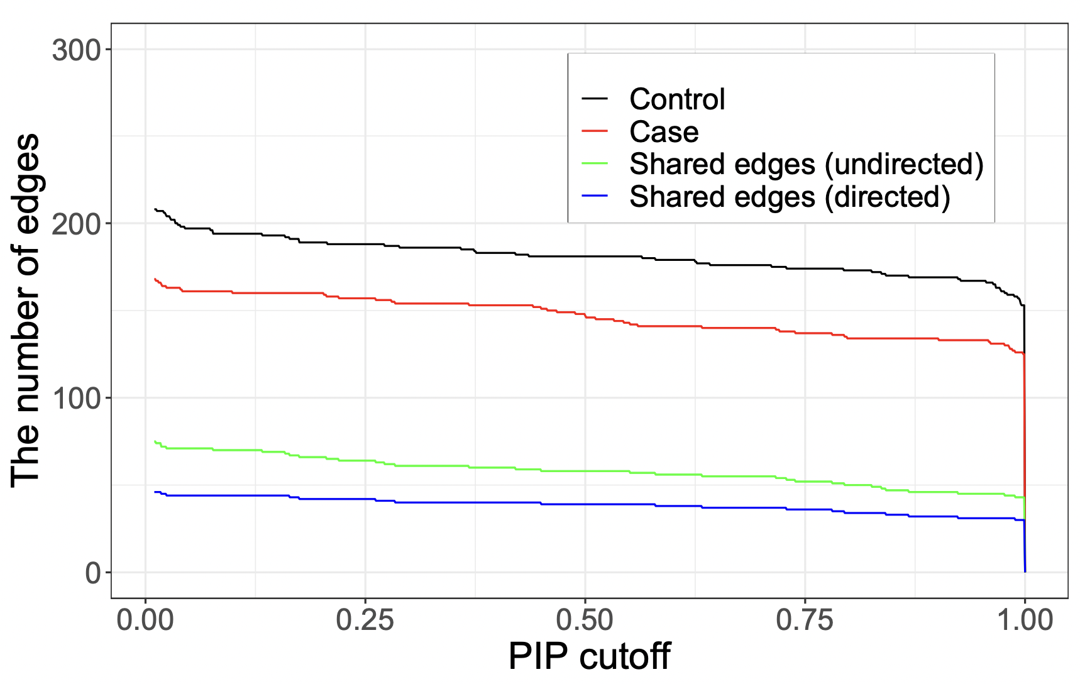
Real data analysis
Ours (without score equivalence)
Minimal I-MAP MCMC(with score equivalence)

Slide 28
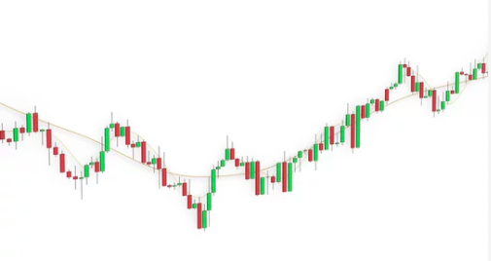
Motivation

Slide 29
Bayesian network and structure learning
Bayesian network
Structure learning on DAG model
1
G*

